Slide 1
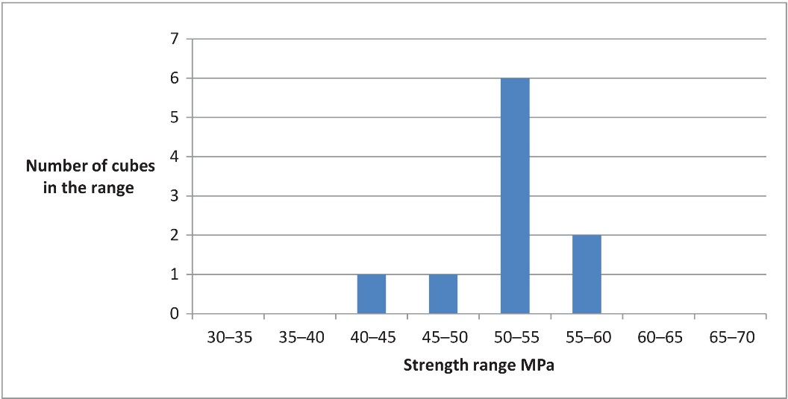
FIGURE 12.1 Strength Results for 10 Cubes

Slide 2
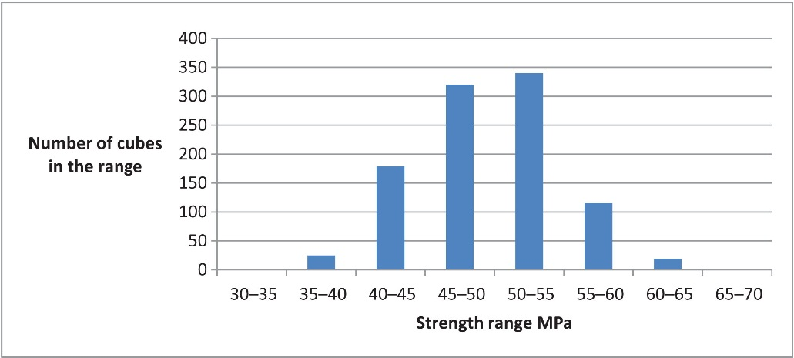
FIGURE 12.2 Strength Results for 1000 Cubes

Slide 3
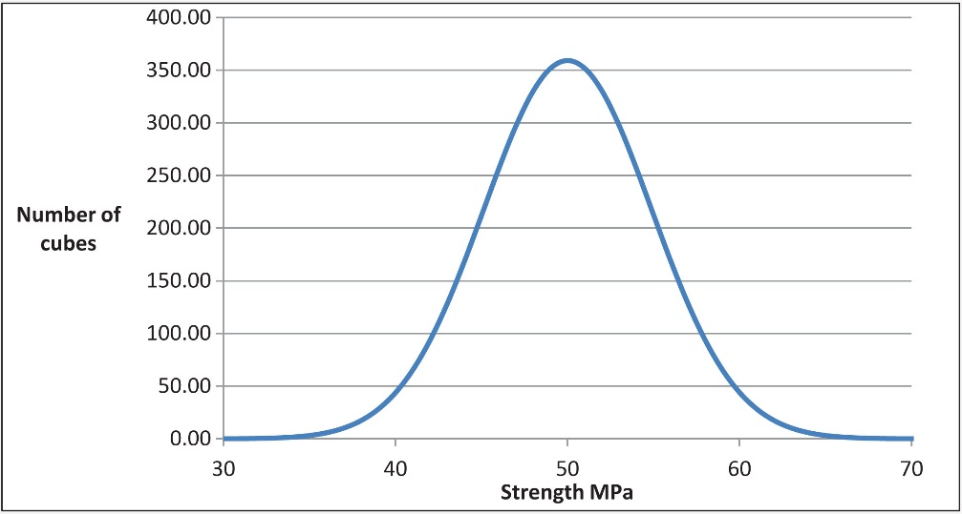
FIGURE 12.3 Normal Distribution for Strength

Slide 4
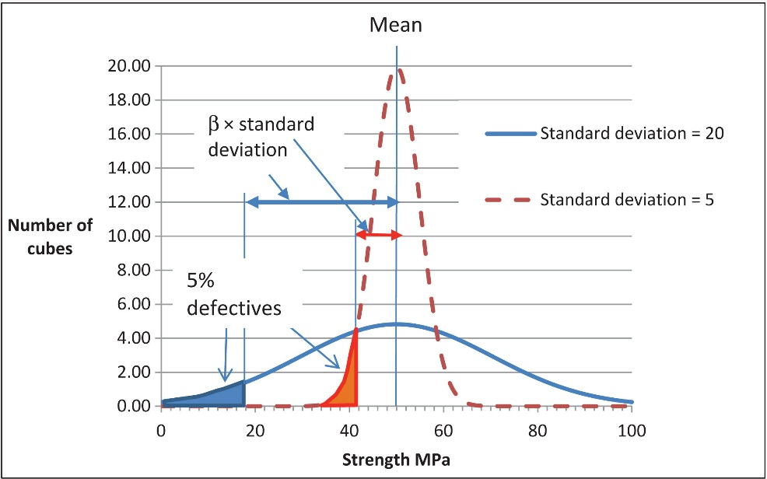
FIGURE 12.4 Two Strength Distributions with Different Standard Deviations

Slide 5
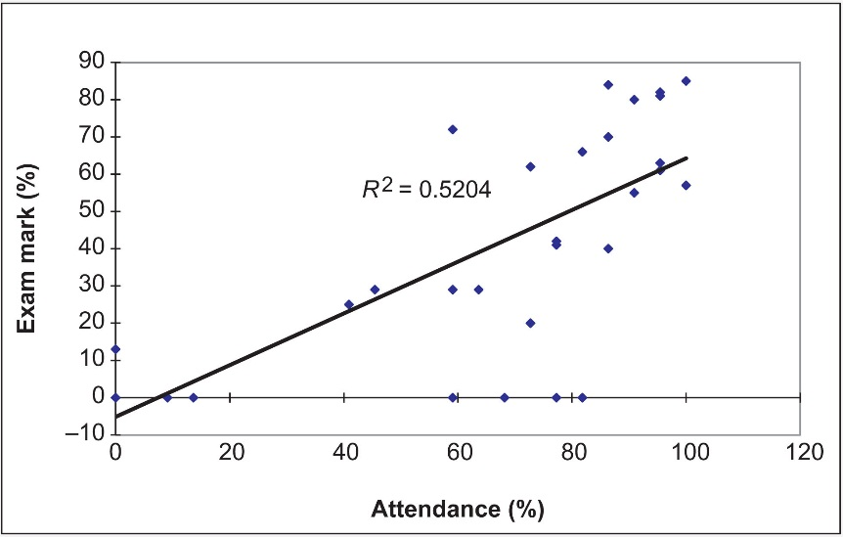
FIGURE 12.5 Exam Mark Versus Percentage Attendance

